Slide 1
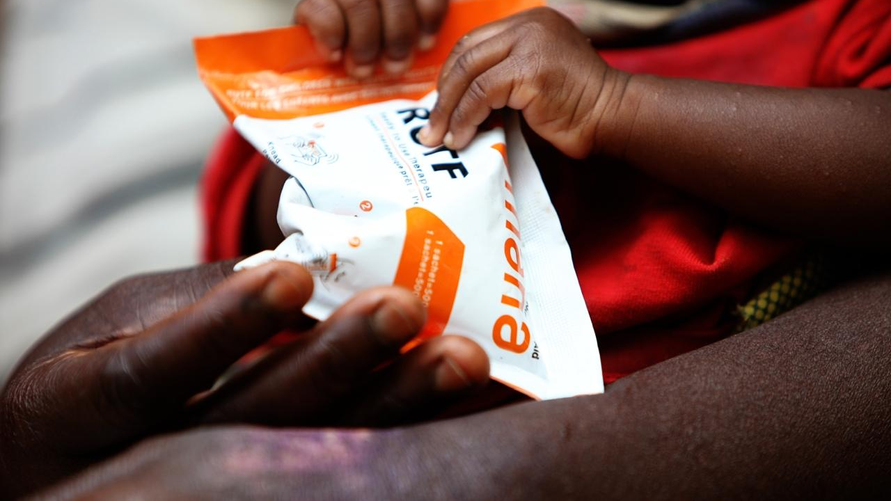

workplace wellness challenge

Slide 2
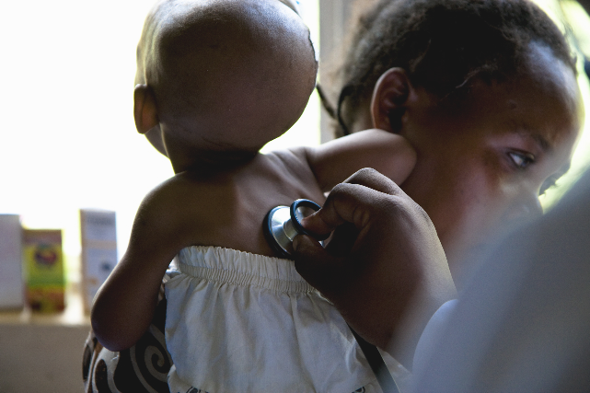
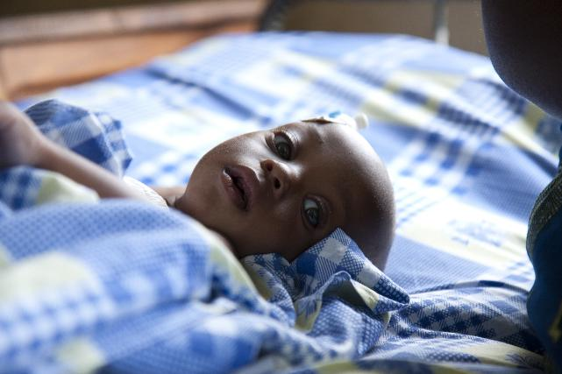
17
million children under the age of 5 suffer from SAM — Severe Acute Malnutrition. The most dangerous form of malnutrition.
global tragedy
.
3 5
million children die each year from SAM. 9,600 each day = one child every 9 seconds. More than AIDS, Malaria & TB combined x 3
178 million total children under the age of 5 suffer from malnutrition in the developing world.

Slide 3

tragic, yet there is
hope.

Slide 4
RUTF is a fortified peanut paste clinically certified to treat Severe Acute Malnutrition (SAM).
A 6-week feeding program (three 500-calorie packs of RUTF per day) permanently eliminates SAM for 95% of the children treated.
Donors currently provide $200 million per year globally to purchase RUTF — enough for 20% of the children.
about 4 million SAM children are saved with ready-to-use therapeutic food (RUTF).

Slide 5

what SAM looks like.
click to play video.

Slide 6


13 million children still go untreated.
3.5 million children die
9.5 million children beat SAM, yet suffer permanent and severe disabilities
up to 4 million children saved
*children with severe acute malnutrition

Slide 7
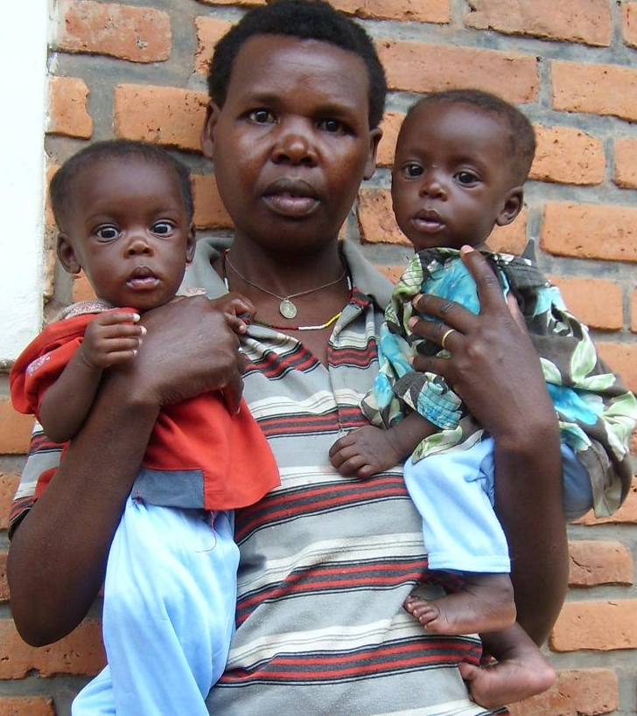
The funding gap is comparatively small by global heath cost standards.
tragic gap
An additional $800 million would provide enough RUTF for the 13 million children untreated.
If produced, distribution channels are in place to deliver the additional RUTF via aid organizations.
For global health cost perspective:
America’s total expenditure on healthcare is $7.8 Billion per day (according to 2013 World Health Organization & CDC statistics)

Slide 8
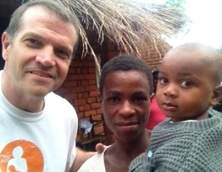
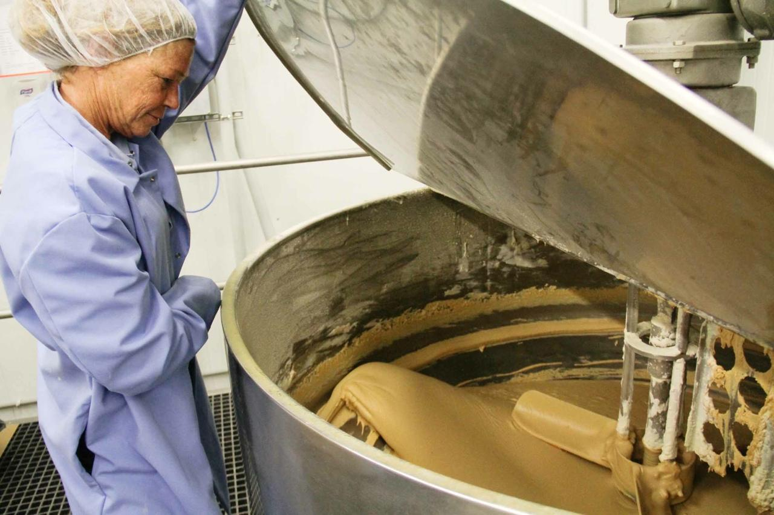
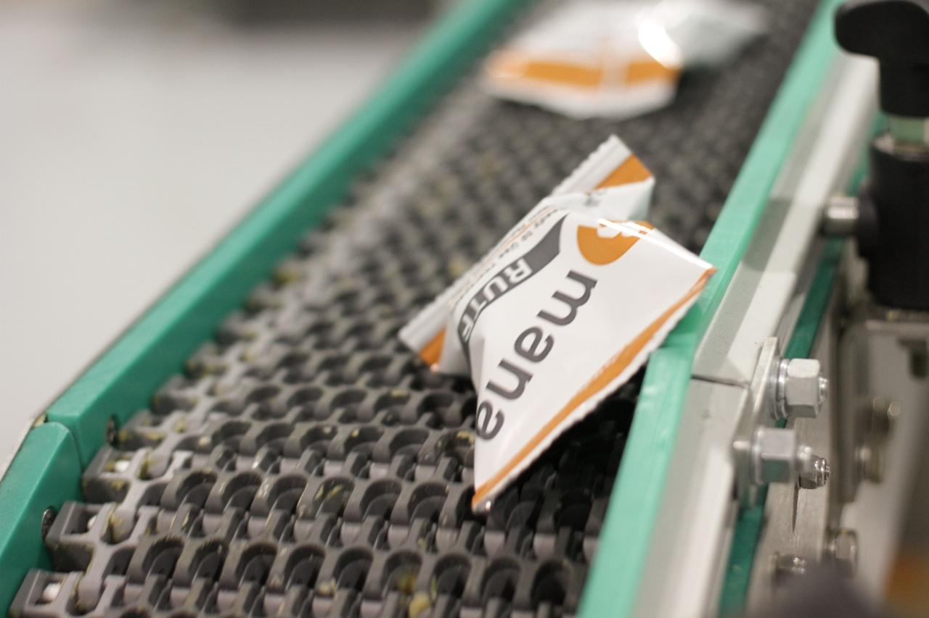
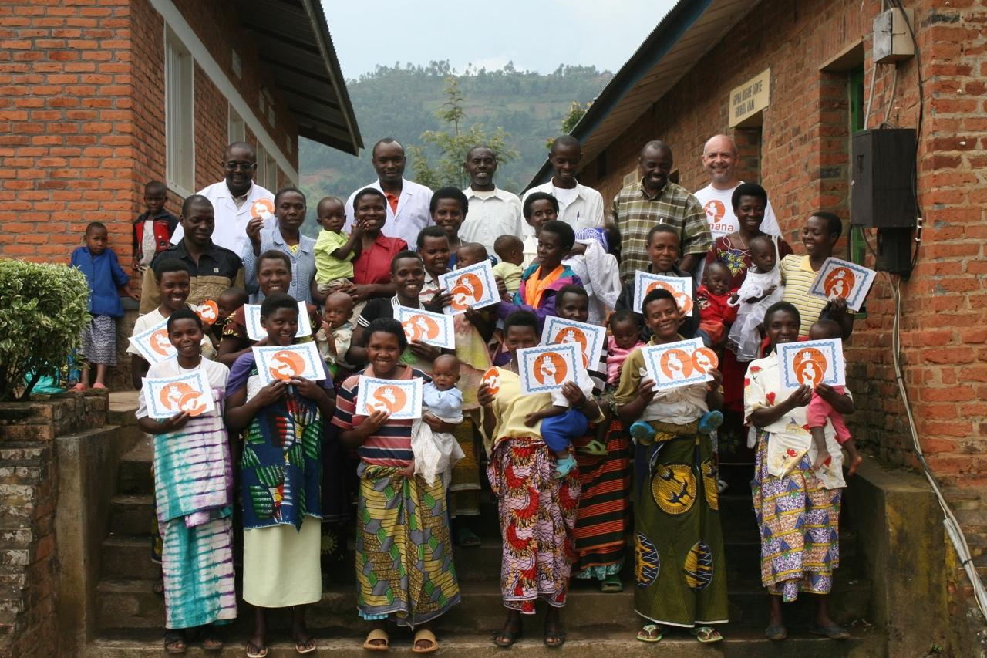
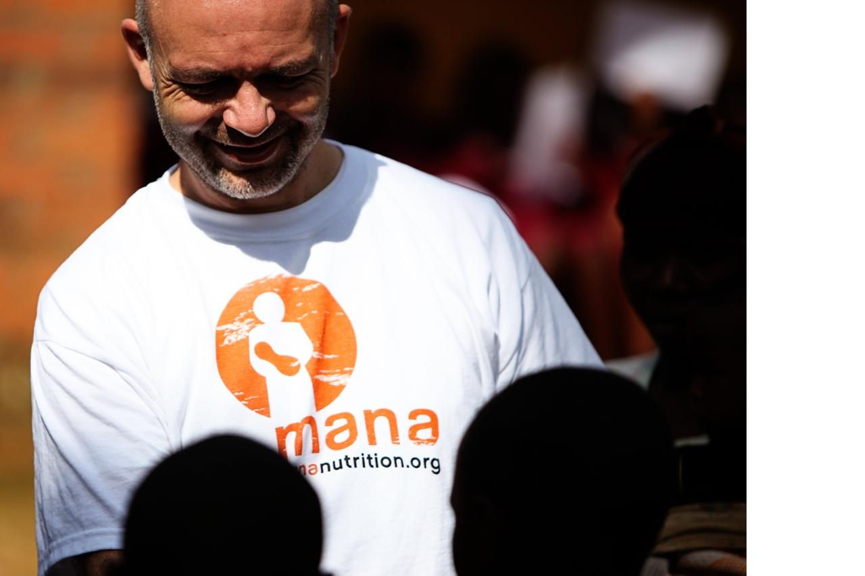
MANA is a non-profit, leading the global effort to eliminate SAM.
Meet MANA Nutrition
MANA (Mother Administered Nutritive Aid) has produced 187 million packets of RUTF and served 1.25 million children to date.
At capacity, MANA could double current production and produce 1 million RUTF packets per day, enough to serve 8,000 lives.
MANA is just one of the RUTF production facilities around the globe, all of whom have distribution partners in county.
Formed in 2009 by Mark Moore, previously an African specialist for the U.S. Senate, and missionary in Uganda for over 10 years.

Slide 9

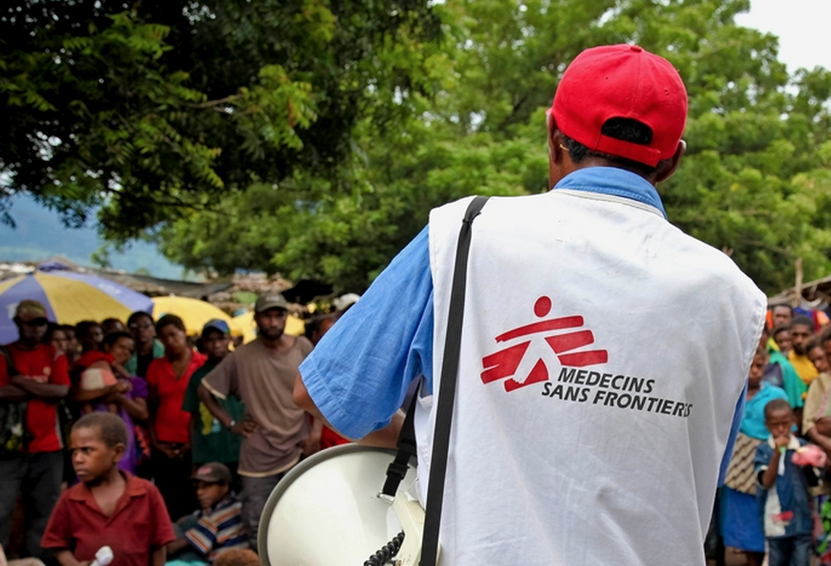
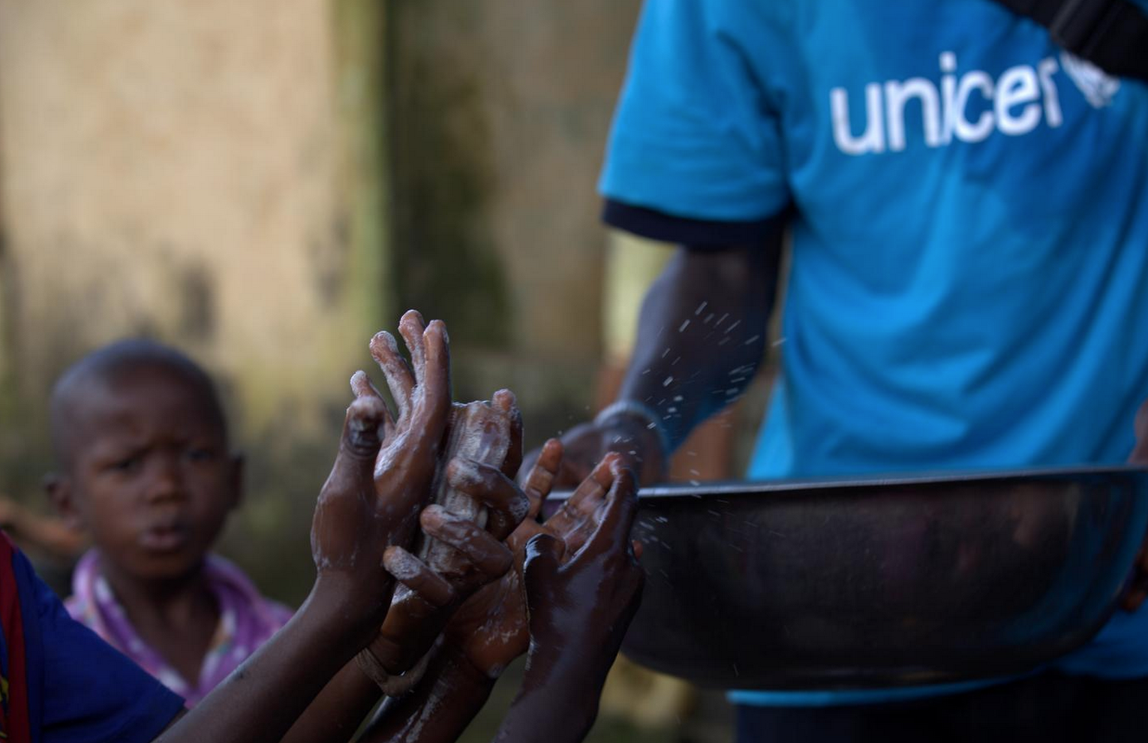
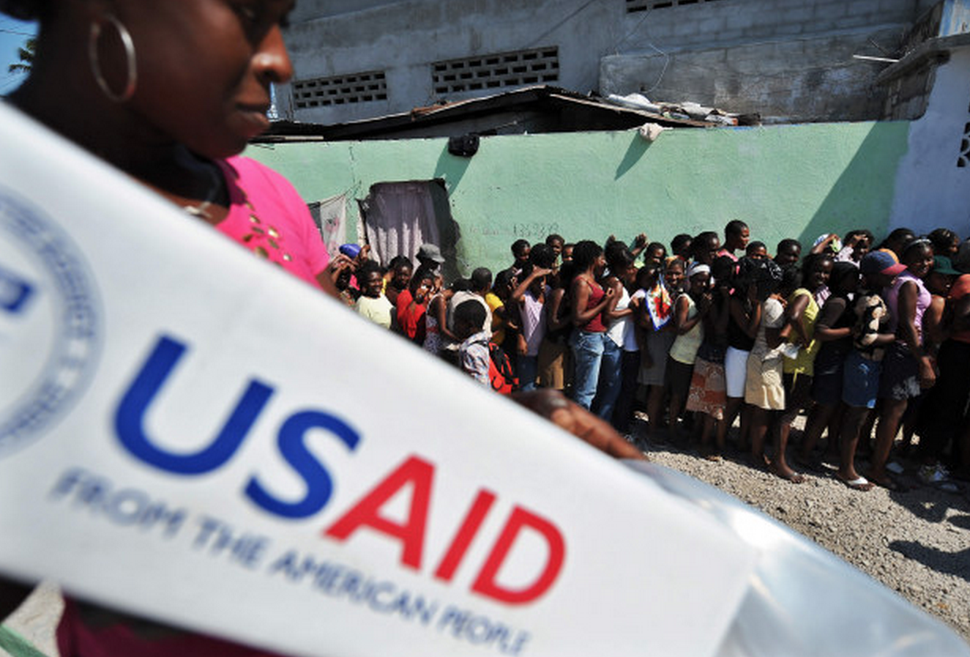

Partners include
Save the Children, USAID, UNICEF,
World Vision, Doctors Without Borders
various ministries of health and other international aid agencies

Slide 10
The primary barrier to
activating the full capacity
of MANA’s production facility
and other RUTF facilities is a lack of funding.
And where resources lack on one side of the world, they’re prevalent on the other. Meet, the calorie paradox:

Slide 11

the calorie paradox:
$66 billion
is spent annually by Americans attempting to lose weight
$200 million is spent on RUTF
for Severely Malnourished Children to gain weight
$200M
$66B

Slide 12

the calorie paradox:
With half of the world under-fed, half is over-fed.
In addition to excess calorie consumption, inactivity is a primary cause of obesity.
This makes Severe Acute Malnutrition (SAM) doubly tragic, unless we make it an opportunity.
78 million adults (38%) and 13 million children (17%) in the U.S. are obese.
Obesity related diseases contribute to 1-in-10 deaths, the second leading cause of preventable deaths.
The direct and indirect cost of obesity is more than $190 Billion annually.
Childhood obesity results in 47% higher medical costs than children with healthy weight.

Slide 13

sitting is the new smoking

Slide 14


if we bridge the calorie paradox
h pe.
there’s

Slide 15
Imagine a “Calorie Cloud” where we could donate calories from those with too many
to those with too few? *
What if those attempting to lose weight, or get in better shape, were more motivated to do so if they could “give” their calories away?
What if we could transfer our burned calories to a “Calorie Cloud”, monetize these calories at the rate of RUTF ($0.50 / 500 calories), and give these calories to SAM victims?
What if the “Calorie Cloud” was a corporate wellness program that organizations used to increase employee activity and teamwork, improve health and reduce health insurance?
What if companies could fund this corporate wellness program from a foundation or charitable contributions budget, thus leaving their HR budget intact?
What if individuals and organizations on both sides of the calorie paradox could benefit by collaboration?
* whether attempting to lose weight or not, Calorie Cloud is for all types of individuals & organizations in the over-nourished parts of the world

Slide 16
What if
you could start today?

Slide 17

workplace wellness challenge
ways to benefit:

Slide 18


Calorie Cloud is a 501c3 dedicated to solving the imbalance of calories on this planet.
what is calorie cloud
Founded in 2013 by the team at MANA Nutrition, Calorie Cloud is a nonprofit health startup building tech platforms to increase the health of adults & kids around the world.
Mission: use technology to double the global budget for Ready-to-use Therapeutic Food (RUTF), the main line of defense against Severe Acute Malnutrition (SAM).
How: by creating platforms to quantify, then monetize, the physical activity of adults and kids all over the world. Then using these funds to save malnourished children.
One of these platforms is the Workplace Wellness Challenge:

Slide 19








workplace wellness challenge
social wellness program
Individuals compete in teams to burn the most amount of active calories
automatic and verified
Participants use activity trackers to automatically sync their calorie data to Calorie Cloud in a verified process
BYOD – bring your own device
Fitness is personal. Love your Fitbit? Use it. Need trackers for your team? We have great deals on the top brands
defined period of time
The Challenge has a start date and an end date. We recommend 30-45 days
burned calories = donated calories
All the calories burned during the program are donated, one-for-one, in the form of RUTF
ready-to-use therapeutic food (RUTF)
RUTF cost $0.50 / packet. 1 packet = 500 calories. For every 500 calories burned, you donate 1 packet of food
calories are cheap. multiply your impact!
We recommend that SMB’s donate at a 1:2 or 1:5 rate. For every 1 calorie burned, 5 calories are donated.
increased motivation
Helping others – by saving the life of a child – increases participation rate & individuals overall level of activity

Slide 20
the typical timeline
initial calls
challenge preparation
the challenge
challenge wrap-up
start
end
1+ month
4 – 6 weeks

Slide 21
the typical timeline
Calorie Cloud
Setup challenge platform
Monitor data, send reminders to create accounts
Place the
RUTF order
Send an
impact report
Ship trackers
Send challenge invitation
Send progress emails throughout challenge
Get participants
email addresses
Send targeted notifications
start
end
Share the
good news!
Get active
Save lives
Monetize
the calories
Order trackers ($)
Distribute trackers
Accept invitation
Wear trackers
Internal “heads-up” email
Share participants
email addresses
Create account & connect tracker
organization
initial calls
challenge preparation
the challenge
challenge wrap-up
1+ month
4 – 6 weeks

Slide 22
cost structure
Platform Fee:
$10 per person < 1,000 people
$5 per person ≥ 1,000 people
+
Cost to Donate Calories:
1 RUTF Packet = 500 calories
500 calories cost $.50
Example:
(100 people | 500 avg cal burn / day)
$10 x 100 ppl = $1,000
100 ppl x 30 days x $.50 = $1,500
$1,500 x 2X Impact = $3,000
recommend 2X impact􏰂 | $1.00 for 500 calories *
example total = $4,000
+ device cost (next slide)
To save the life of 1 child suffering from malnutrition:
126 packets of RUTF | 63,000 calories | $63
* Adding an Impact Multiplier to your challenge saves more lives and increases the rate of your progress such that more can be accomplished in a defined period of time.

Slide 23







recommended activity trackers
Fitbit
Jawbone
Pivotal Living
Garmin
Moves
Withings
Misfit

Slide 24
reasons to love our platform
Malnourished kids survive and thrive
Every calorie burned during the program is recycled into therapeutic food to save the life a severely malnourished child.
^{People Like It}
86% of employees surveyed in our pilot programs said they were more active when they knew it was helping someone else at the same time. People appreciate working at a company that supports worthy causes and creatively engages people to be healthy.
^{HR Friendly}
Our platform is easy to administer and communicate.
Outside of the initial conversations, you get to sit back & relax!
^{Finance Loves the Math}
Calorie Cloud is a registered 501(c)3 organization and our platform was built with grant money. This allows us to deliver the program at a very low cost. Companies can fund the program from a foundation or charitable contributions budget leaving their HR budget intact.

Slide 25
unique benefits
BYOD (Bring Your Own Device or App)
Already own a Fitbit or Jawbone Up? Using Nike+ or
Garmin? You can connect over 100 fitness devices
and apps to Calorie Cloud, making it flexible for
different fitness interests and goals.
^{Hosted and Secure}
Nothing to download or install. When an employee
connects a device or app, only the fields necessary
to track calorie-burning activities are pulled into
^{the Calorie Cloud dashboards.}
^{Your Brand}
Co-brand the web platform with your company branding
and messaging. We have been working with designers,
researchers, and wellness experts to build a best-in-class
^{wellness challenge platform.}
^{Pay For Results}
As a company sponsoring your employees fitness activity,
you pay for the calories participants burn; not a flat rate for all employees. This keeps our missions aligned: it’s our priority
to make the program engaging for your teams.

Slide 26





company examples
60 employees participated in a 30-day wellness challenge
and contributed just under 1 million calories.
PepsiCo organized a program at their Plaza location in Chicago.
155 employees participated􏰃, 3x the number they expected!
JPMC organized a program called Step Up for Global Hunger, a 3-month long activity challenge
for all 270,000 of their employees. More than 50% of employees participated in both 2014 and 2015.
125 individuals participated in a 60-day challenge during Summer 2014.
The program saved the lives of 32 children suffering from malnutrition.
Johnson & Johnson had 657 individuals (82% of all event attendees) participate in a 30-day Calorie Cloud Challenge
that launched during their TED^{x} event. The challenge contributed 10 million calories, 20,000 RUTF packets, and saved 133 lives.

Slide 27
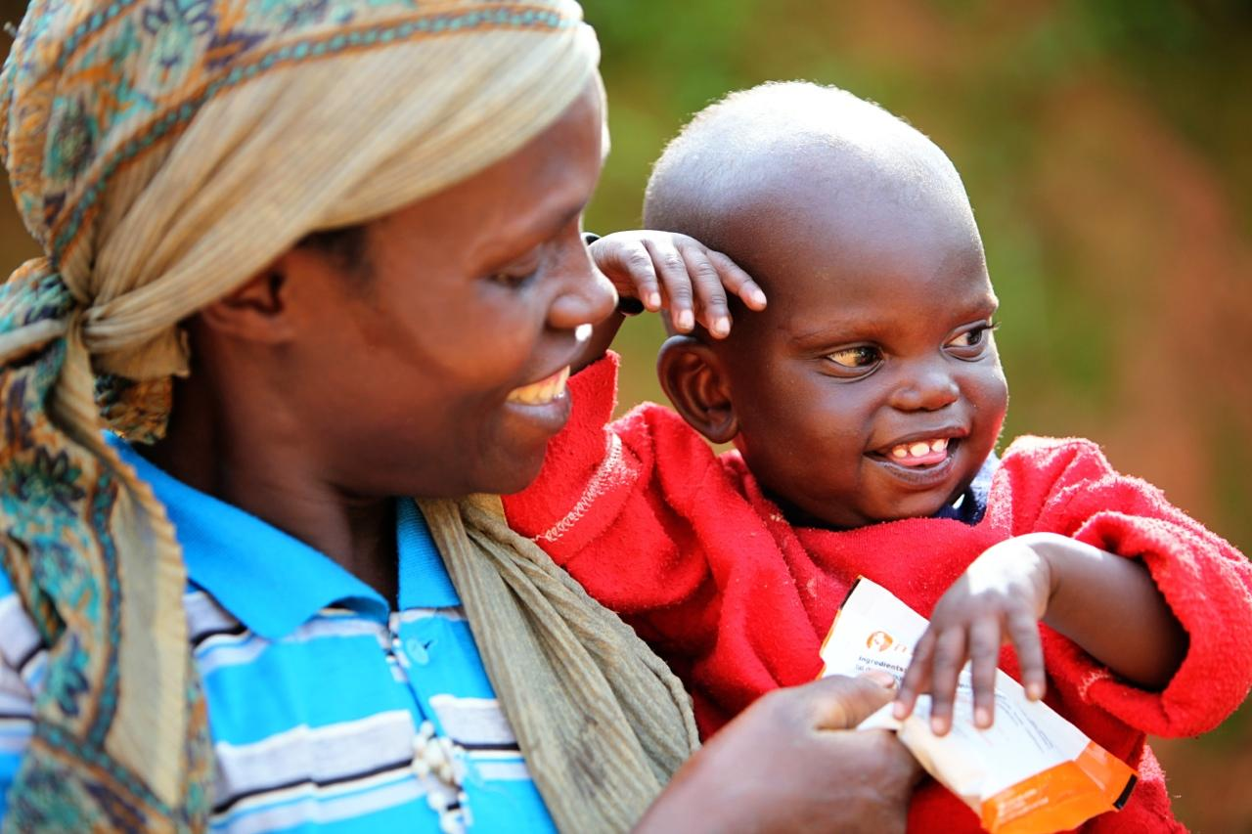
Other ways to help and benefit.
Already have a corporate wellness program? Apply our messaging layer to your existing platform!
Organize a company weight loss contest & donate your weight.
Accelerate the development of a Calorie Cloud technology platform.
Connect Calorie Cloud to other organizations.
Make a Direct Donation for RUTF production.

Slide 28
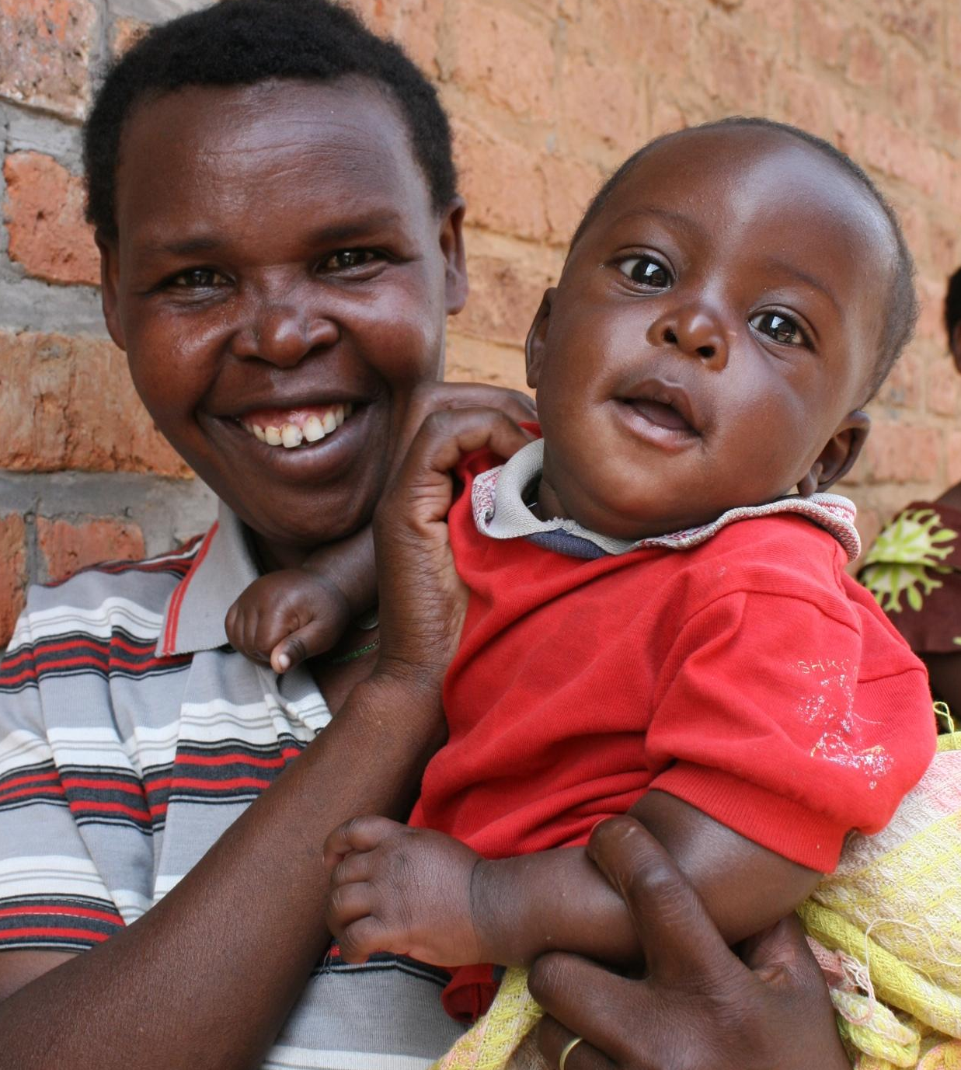
our urgent request
With a child dying every 9 seconds, time matters!
We’re a 501c3 dedicated to ending the imbalance of calories on this planet.
Will you join us?
contact:
Mark Shenfield > 970.819.4055 m@caloriecloud.org
Ester Fiedler > 847.809.2581 ester@caloriecloud.org

Slide 29
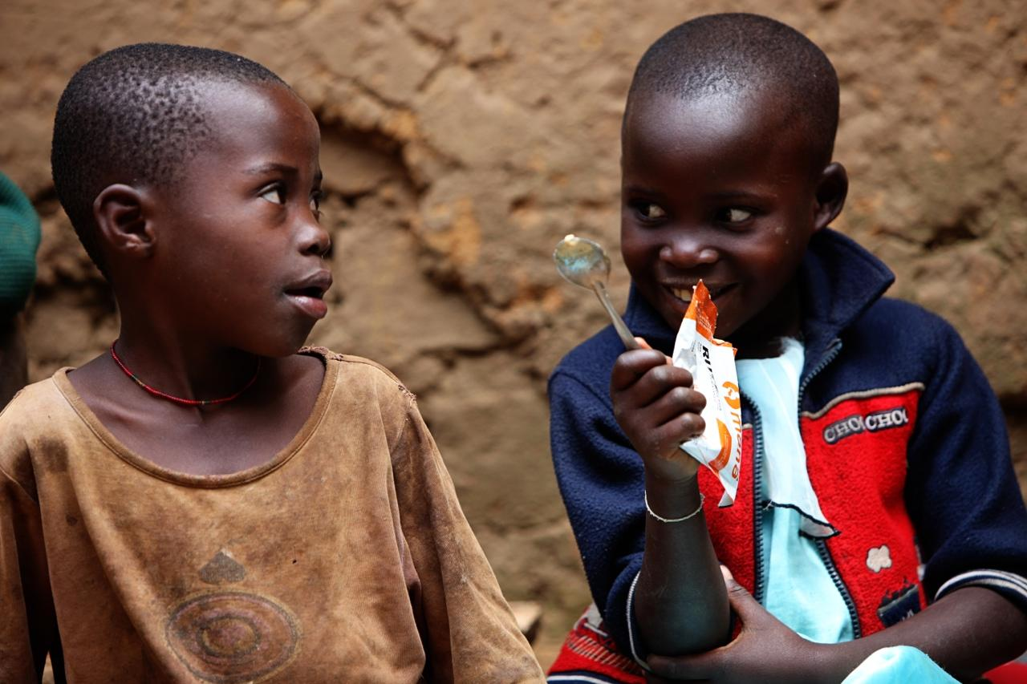
A few examples of win/win programs
ways to benefit:

